Slide 1
Economics of education and quasi-experimental methods
Astrid Marie Jorde Sandsør

Slide 2
Endre til neste år
Andre eksempler på RD/IV/DD (sjekke SPED4010 slides, muligens bruke AKS som eksempel på DD)
Bygge opp eksemplene fra spørsmålene, ikke fra metoden
Ta vekk siste slide
Relatere mer til hva de holder på med

Slide 3
What is economics of education?
Economics: What is the best possible use of limited resources?
Trade off between sector – health or education?
Trade off within sectors – what is the best way to increase learning?
Why do we care about this? Human capital theory
Learning (human capital accumulation) depends on…
Student characteristics
Family characteristics
Individual skills
Resources
Institutions

Slide 4
What is economics of education?
Economics: What is the best possible use of limited resources?
Trade off between sector – health or education?
Trade off within sectors – what is the best way to increase learning?
Why do we care about this? Human capital theory
Learning (human capital accumulation) depends on…
Student characteristics
Family characteristics
Individual skills
Resources
Institutions
What can we influence through policy?

Slide 5
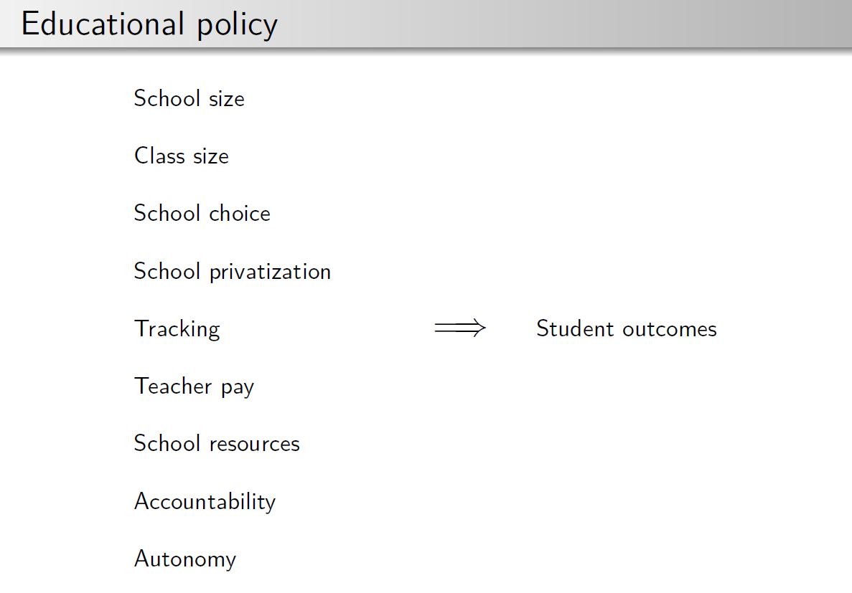

Slide 6
Fundamental questions (Angrist & Pischke, 2009)
What is the causal relationship of interest?
What experiment could ideally be used to capture the causal effect of interest?
What is your identification strategy?
What is your mode of statistical inference?

Slide 7
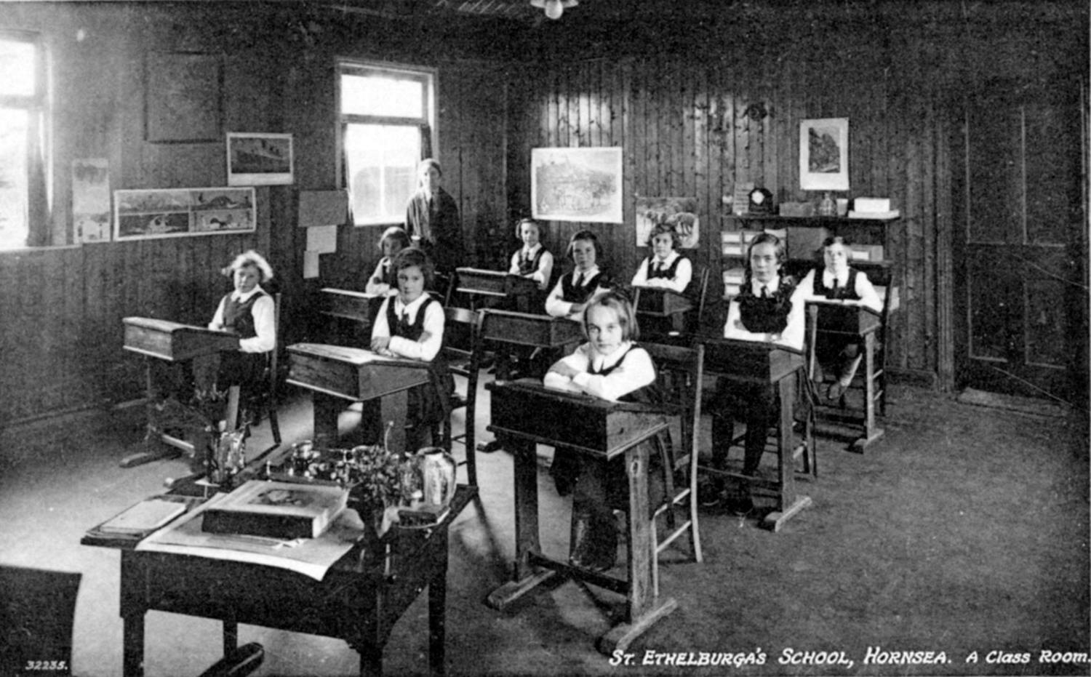
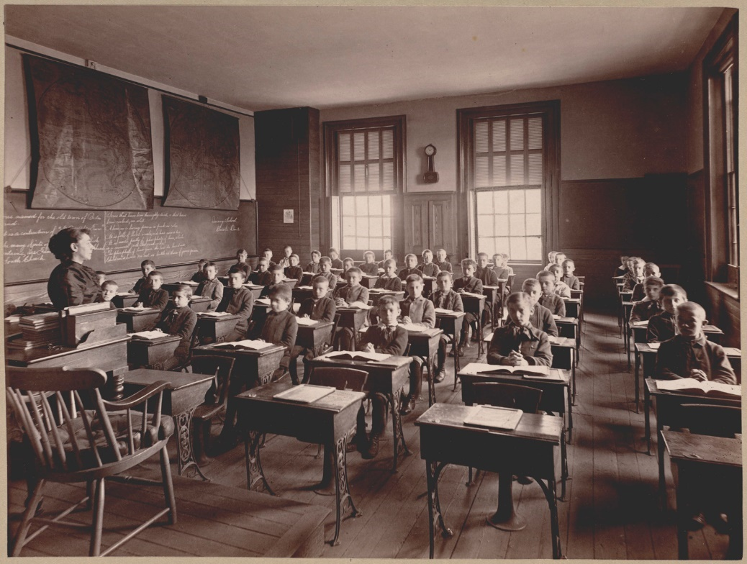
Do smaller classes increase test scores?
Bradford Timeline, Flickr; nifu.no
Boston Public Library , Flickr; nifu.no

Slide 8

Do smaller classes increase test scores?
The perfect experiment
Bradford Timeline, Flickr; nifu.no
What would my test scores be if I was in a small class compared to what they would be if I was in a large class?
(Potential outcomes)
Boston Public Library , Flickr; nifu.no

Slide 9
Do smaller classes increase test scores?
The perfect experiment
Bradford Timeline, Flickr; nifu.no
We can never observe the same people at the same time both in small and large classes: we never directly observe the counterfactual
Boston Public Library , Flickr; nifu.no

Slide 10
Do smaller classes increase test scores?
The main problem…
Bradford Timeline, Flickr; nifu.no
Selection bias:
What will a comparison of people in small and large classes capture?
Who is more likely to be in a larger class?
Boston Public Library , Flickr; nifu.no

Slide 11


The next best thing: a Randomized Controlled Trial
Causal impact of smaller classes
Random assignment
Treatment group
Comparison group
Pixabay.com

Slide 12


The next best thing: a Randomized Controlled Trial
Causal impact of smaller classes
Treatment group
Comparison group
Pixabay.com

Slide 13
Randomized Controlled Trial
People who have access to the program are selected randomly into treatment
Ensures that there are no systematic differences between those who receive program (treatment group) and those who serve as comparison group
Observable characteristics (e.g. family background) are balanced across groups
Unobservable characteristics (e.g. motivation, talent) are also balanced across groups
On average, treatment and comparison groups are comparable when program starts, and would have followed the same development in the absence of a program
Comparing the outcomes of the two groups gives us the causal effect of treatment

Slide 14
The next-next best thing: a quasi-experiment
Similarities between true and quasi-experiments:
Aim to estimate effects free of confoundedness, reverse causality or simultaneous causality
Study participants are subjected to some type of treatment or condition
Some outcome of interest is measured
The researchers test whether differences in this outcome are related to the treatment
But since treatment is no longer randomized quasi-experiments exploit existing circumstances in which treatment assignment has a sufficient element of randomness
Also called natural experiments because of using «natural» random variation

Slide 15
The next-next best thing: a quasi-experiment
Difference-in-differences (DD)
Regression discontinuity (RD)
Instrumental variables (IV)
Angrist, J. D., & Pischke, J. S. (2008). Mostly harmless econometrics: An empiricist's companion. Princeton university press. https://www.researchgate.net/publication/51992844_Mostly_Harmless_Econometrics_An_Empiricist's_Companion
Angrist, J. D., & Pischke, J. S. (2014). Mastering 'metrics: The path from cause to effect. Princeton University Press.
Cunningham, S. Causal inference: The Mixtape. YALE University Press. https://scunning.com/cunningham_mixtape.pdf

Slide 16
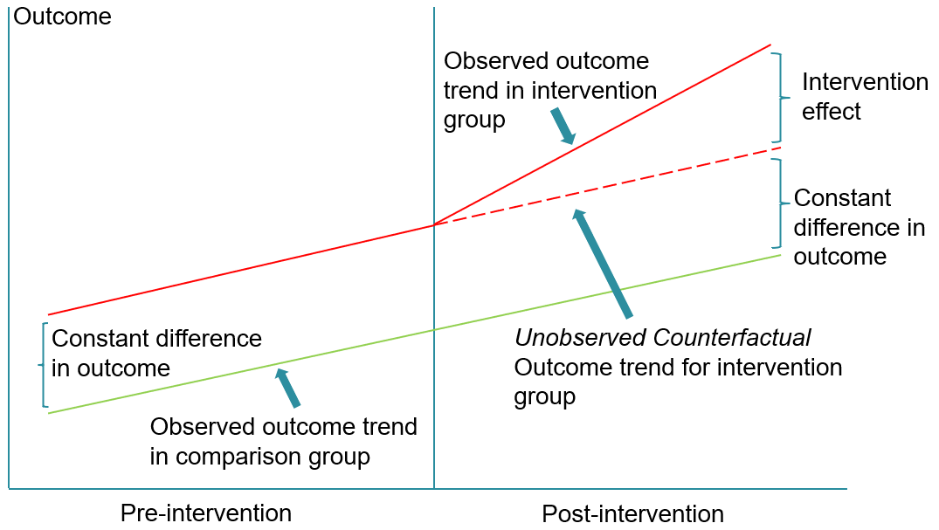
Difference-in-differences (DD)
Compare average change between treatment and control group (first difference) over time (second difference)
Common trends assumption

Slide 17
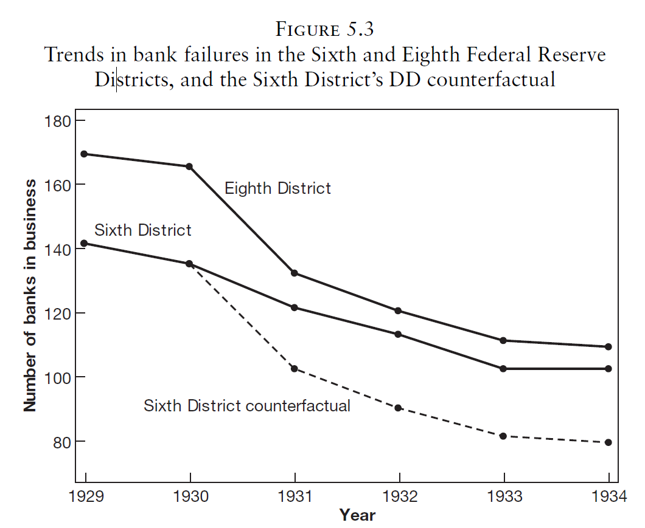
Difference-in-differences (DD)
Example: Lending vs. credit rationing during a recession
First difference:
6th district favored lending (treat)
8th district favored restricting credit (non-treat)
Second difference:
Before crisis (pre)
After crisis (post)
More lending caused fewer bank closures…
… and fewer firm bankruptcies
Border between 6th and 8th district ran smack through middle of Mississippi
Richardson, G., & Troost, W. (2009). Monetary intervention mitigated banking panics during the great depression: quasi-experimental evidence from a federal reserve district border, 1929–1933. Journal of Political Economy, 117(6), 1031-1073. https://doi.org/10.1086/649603

Slide 18
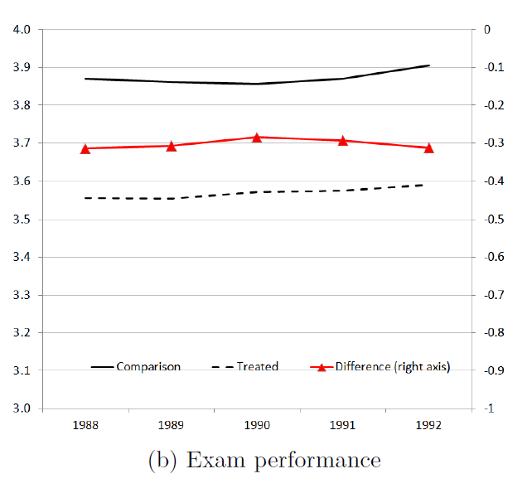
Difference-in-differences (DD)
Example: Effect of Reform 97 (Drange, Havnes & Sandsør, 2016)
First difference:
Children who otherwise would have had informal care (treat)
Children who otherwise would have been in pre-school (non-treat)
Second difference:
Before reform (pre)
After reform (post)
No effect on grades of Reform 97

Slide 19
Difference-in-differences (DD)
CRITICAL QUESTIONS:
Is the common trends assumption valid?
Are there compositional changes?

Slide 20
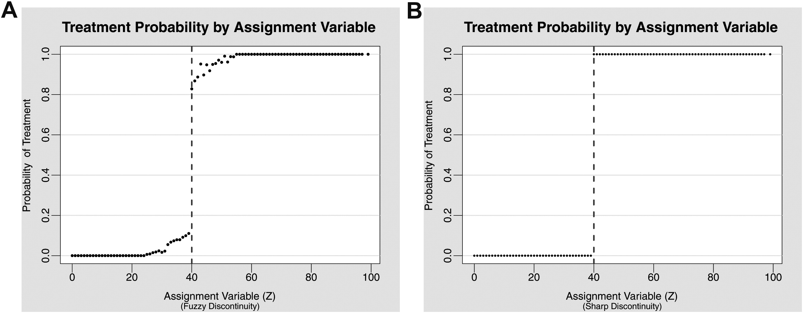
Regression discontinuity (RD)
Decision rule assigns treatment
Comparing outcomes for students just above and below cut-off gives causal effect of treatment

Slide 21
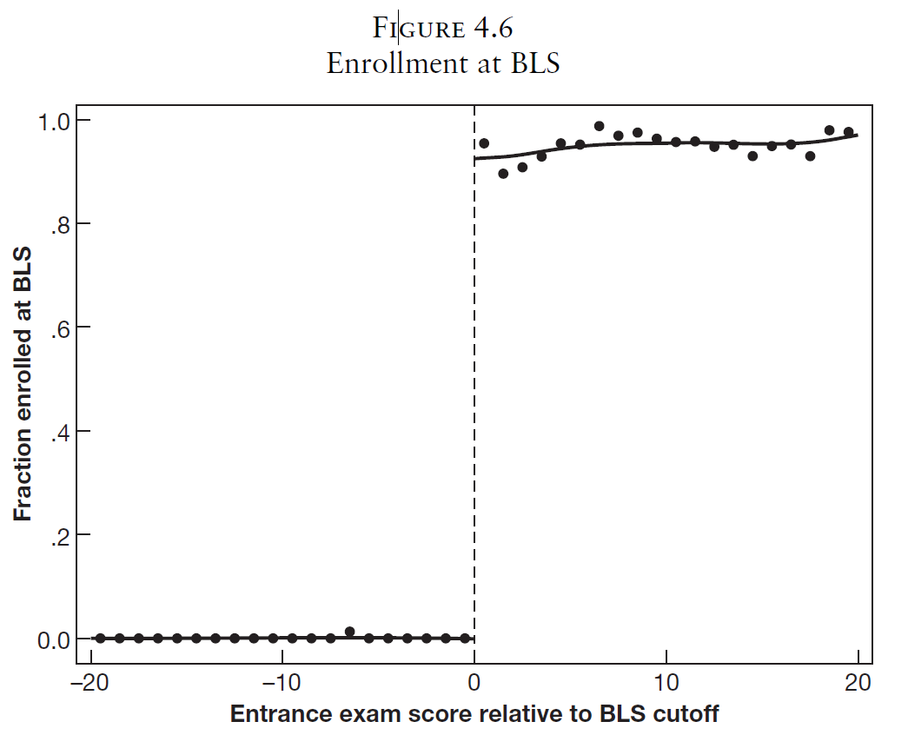
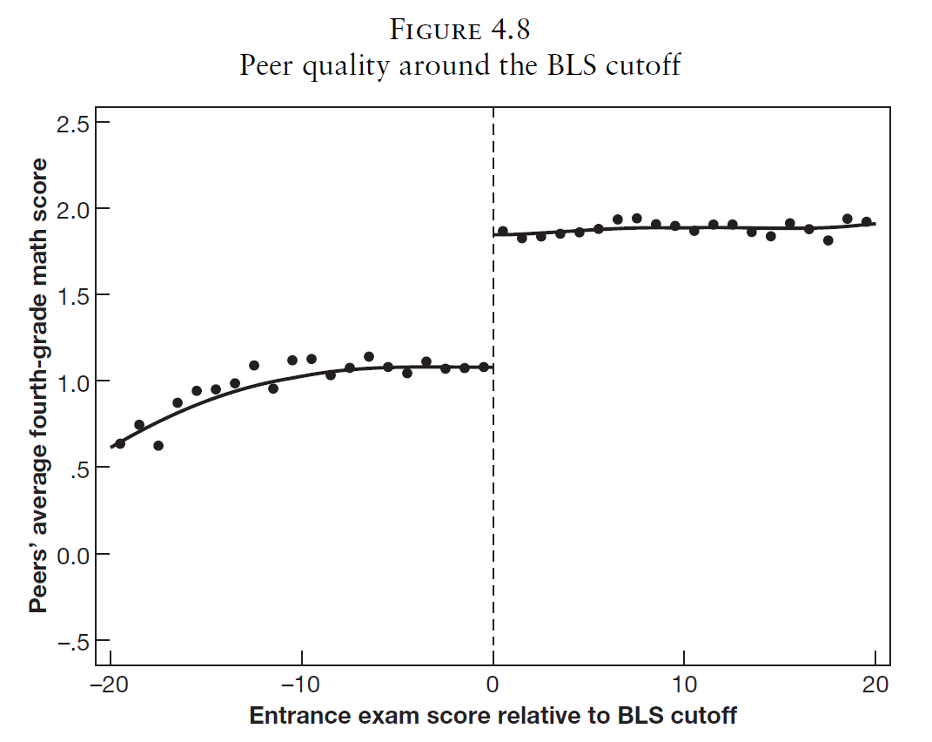
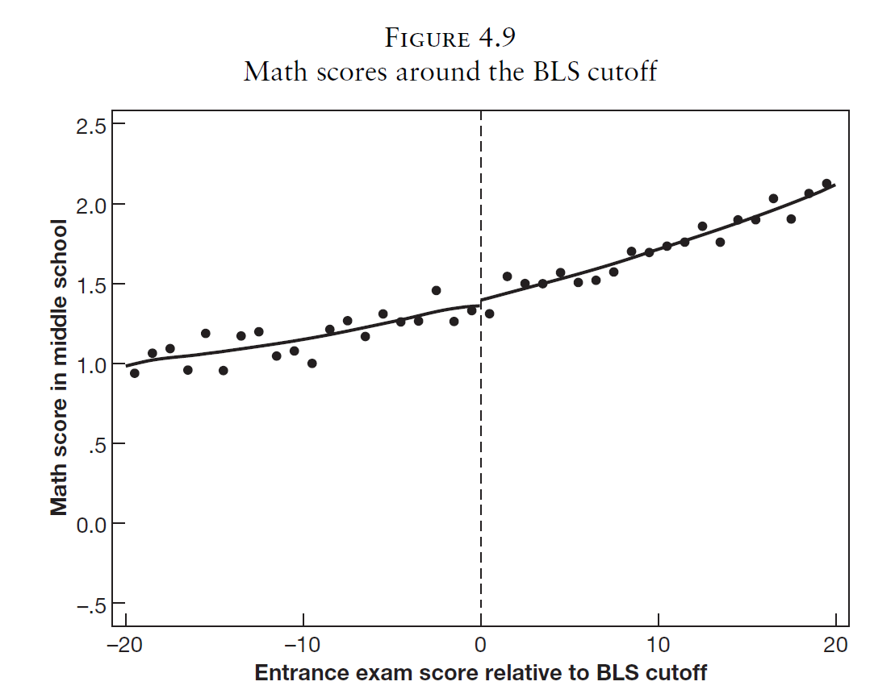
Regression discontinuity (RD)
Boston Latin School (BLS) exam cut-off scores
Abdulkadiroğlu, A., Angrist, J. and Pathak, P. (2014), The Elite Illusion: Achievement Effects at Boston and New York Exam Schools. Econometrica, 82: 137-196. https://doi.org/10.3982/ECTA10266

Slide 22
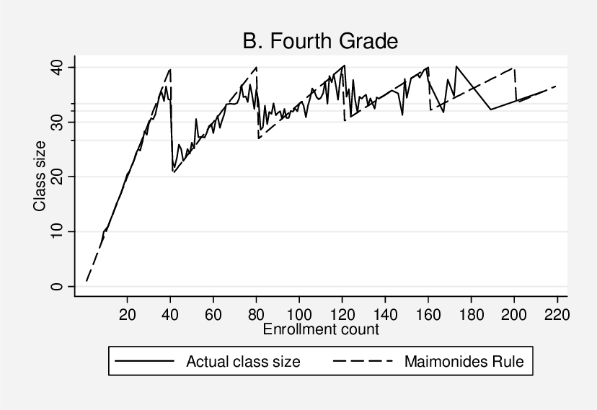
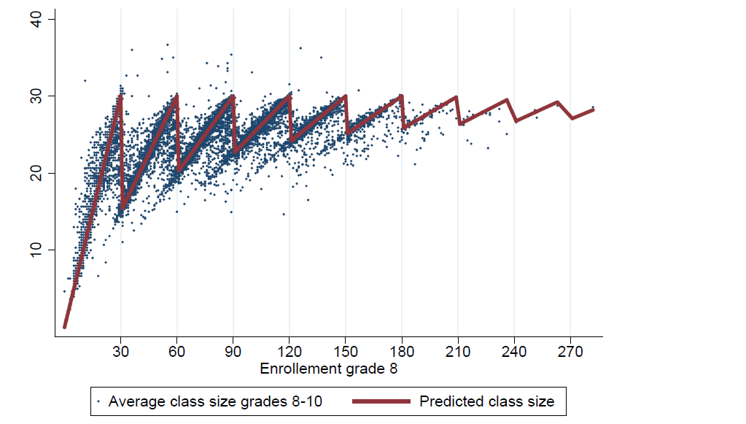
Regression discontinuity (RD)
Effect of class size, Israel
Angrist Lavy (1999)
Angrist, J. D., Lavy, V., Leder-Luis, J., & Shany, A. (2019)
Class size cut-off: 40
Effect of class size, Norway
Leuven, Oosterbeek & Rønning (2008): Grades
Falch, Sandsør & Strøm (2017) and Leuven & Løkken (2018): Income and years of education
Class size cut-off: 30
Angrist Lavy (1999)
Falch, Sandsør & Strøm (2017)

Slide 23
Regression discontinuity (RD)
CRITICAL QUESTIONS:
Is there manipulation around the cutoff?
What is the counterfactual?

Slide 24
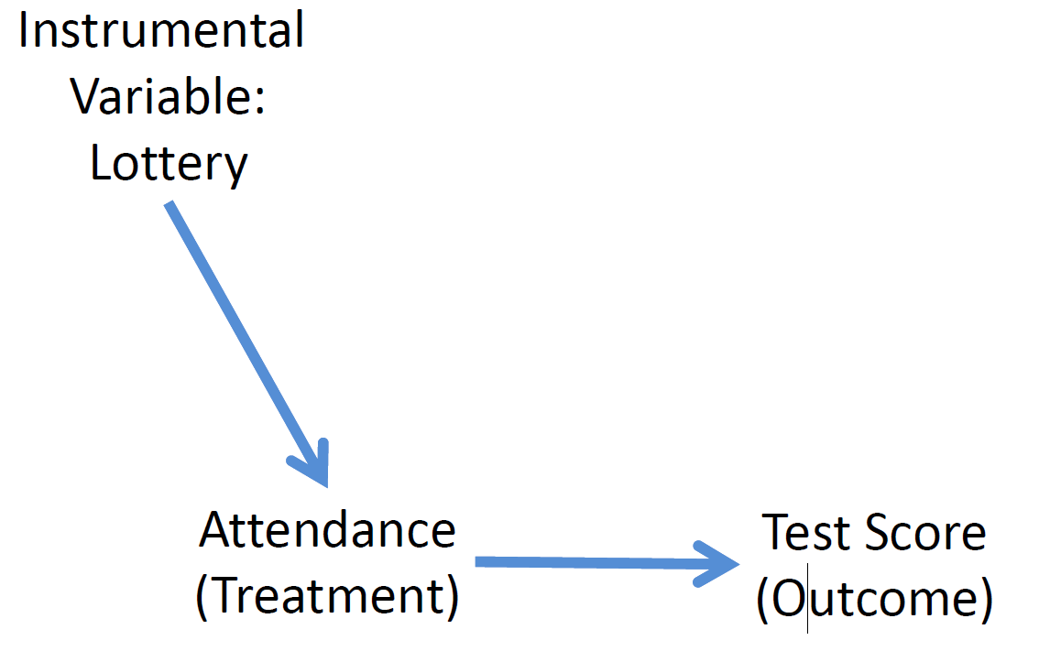
Instrumental variables (IV)
Variable that is correlated with the causal variable and not correlated with other variables that might affect the outcome variable
Instrumental variable should not have an effect on outcome variable though any other channel than through the causal variable

Slide 25
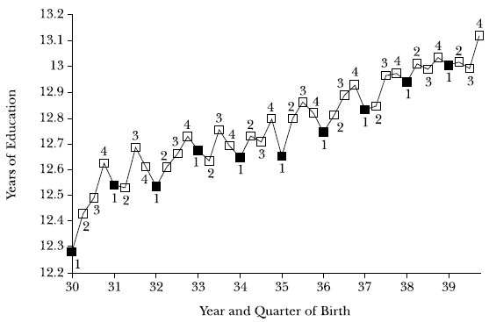
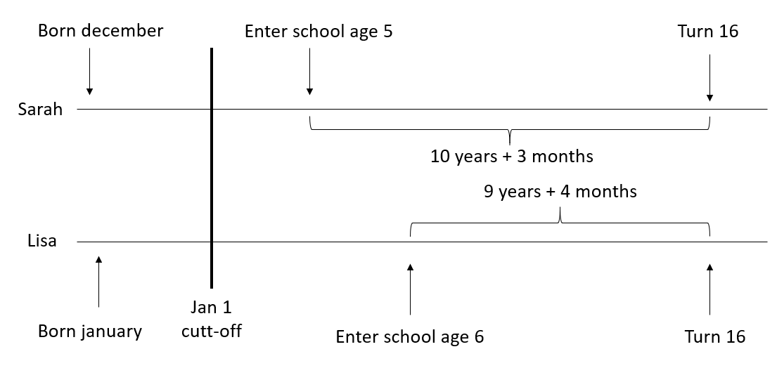
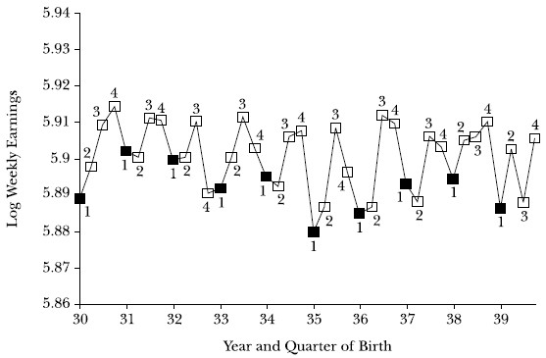
Instrumental variables (IV)
Effect of years of education on income using school laws
Quarter of birth as an instrument for years of education
Angrist, J. D., & Keueger, A. B. (1991). Does compulsory school attendance affect schooling and earnings?. The Quarterly Journal of Economics, 106(4), 979-1014. https://doi.org/10.2307/2937954

Slide 26
Instrumental variables (IV)
CRITICAL QUESTIONS:
Is the IV variable predictive enough? (correlation between IV and causal variable)
Are there any other ways in which the IV variable affects the outcome variable than through the causal variable?
“Because an individual’s date of birth is probably unrelated to his or her innate ability, motivation or family connections, it seems credible to assert that the only reason for the up-and-down pattern in earnings is the up-and-down quarter-of-birth pattern in schooling” (Angrist and Krueger, 1991, p. 119).
Are birthdays random?
Do birthdays affect income in any another way than through years of education?

Slide 27
Back to class size (or teacher density)…
RCT
Quasi-experiments
(Correlational studies)
Tennessee STAR experiment (RCT)
Class size rules (RD/IV)
Strict criteria for receiving resources to hire more teachers (RD)
Comparing municipalities receiving resources to hire more teachers to comparable municipalities over time (DD)

Slide 28
What do we agree on in economics of education?
Human capital is important…
… but it is hard to increase human capital
Teachers are very important…
… but it is hard to improve teacher education or teacher quality
The effect of increasing resources varies
The effect of institutional changes varies
We depend on causal studies to be able to tell us what works, when it works and how well it works

Slide 29
Take home message:
You do not need to know how to do quasi-experiments
Each of these methods takes time to understand and years to master
Requires detailed knowledge of register data and regression analyses using R/Stata
Robustness checks are a big part of it
Typical paper has one table with results and 12 tables with robustness
You should be able to understand the essence of the method
Does the story seem credible?
Are any critical assumptions violated?
Have they understood the reform/policy change in the right way?
Is the interpretation of the results correct?

Slide 30
Literature/references:
Abdulkadiroğlu, A., Angrist, J. and Pathak, P. (2014), The Elite Illusion: Achievement Effects at Boston and New York Exam Schools. Econometrica, 82: 137-196. https://doi.org/10.3982/ECTA10266
Angrist, J. D., & Keueger, A. B. (1991). Does compulsory school attendance affect schooling and earnings?. The Quarterly Journal of Economics, 106(4), 979-1014. https://doi.org/10.2307/2937954
Angrist, J. D., Lavy, V., Leder-Luis, J., & Shany, A. (2019). Maimonides' Rule Redux. American Economic Review: Insights, 1(3), 309-24. https://doi.org/10.1257/aeri.20180120
Angrist, J. D., & Lavy, V. (1999). Using Maimonides' rule to estimate the effect of class size on scholastic achievement. The Quarterly journal of economics, 114(2), 533-575. https://doi.org/10.1162/003355399556061
Angrist, J. D., & Pischke, J. S. (2008). Mostly harmless econometrics: An empiricist's companion. Princeton university press. https://www.researchgate.net/publication/51992844_Mostly_Harmless_Econometrics_An_Empiricist's_Companion
Angrist, J. D., & Pischke, J. S. (2014). Mastering'metrics: The path from cause to effect. Princeton University Press.
Cunningham, S. Causal inference: The Mixtape. YALE University Press. https://scunning.com/cunningham_mixtape.pdf
Drange, N., Havnes, T., & Sandsør, A. M. (2016). Kindergarten for all: Long run effects of a universal intervention. Economics of Education Review, 53, 164-181. https://doi.org/10.1016/j.econedurev.2016.04.002
Falch, T., Sandsør, A. M. J., & Strøm, B. (2017). Do Smaller Classes Always Improve Students’ Long‐run Outcomes?. Oxford Bulletin of Economics and Statistics, 79(5), 654-688. https://doi.org/10.1111/obes.12161
Leuven, E., & Løkken, S. A. (2020). Long-Term Impacts of Class Size in Compulsory School. Journal of Human Resources, 55(1), 309-348. https://doi.org/10.3368/jhr.55.2.0217.8574R2
Leuven, E., Oosterbeek, H., & Rønning, M. (2008). Quasi‐experimental estimates of the effect of class size on achievement in Norway. Scandinavian Journal of Economics, 110(4), 663-693. https://doi.org/10.1111/j.1467-9442.2008.00556.x
Richardson, G., & Troost, W. (2009). Monetary intervention mitigated banking panics during the great depression: quasi-experimental evidence from a federal reserve district border, 1929–1933. Journal of Political Economy, 117(6), 1031-1073. https://doi.org/10.1086/649603

Slide 31
Discussion:
Norwegian teacher density reform
Grant given to the 100 (out of 428) municipalities with the lowest teacher density
Did the grant lead to an increase in teachers?
What could have happened?
Make your hypotheses
Are they testable?
How do we find out?
Can we evaluate this using a quasi-experiment?

